Slide 1
REDCap

Slide 2
OBJECTIVES
Open VMware
Open Nursing VDI
Open Report
Run Code
Report(s) Location

Slide 3
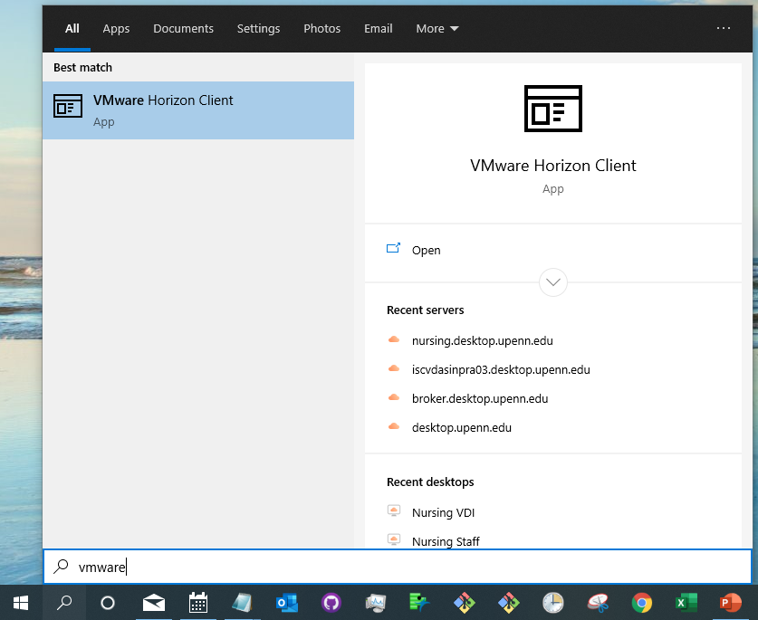
Open Vmware
Select the magnifying glass
Search and select Vmware

Slide 4
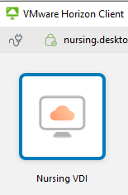
Open Nursing VDI
Sign in with School of Nursing Username and Password
Select Nursing VDI

Slide 5
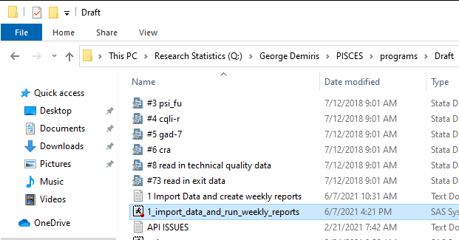
Open Report
Open the following file "Q:\George Demiris\PISCES\programs\Draft\1_import_data_and_run_weekly_reports.sas"

Slide 6
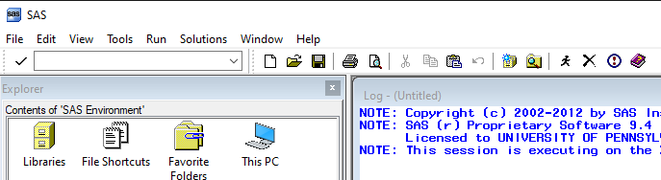
Run Code
Select the running person to run the code and create weekly and monthly reports

Slide 7
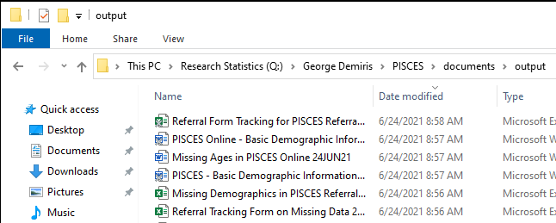
Weekly Reports
Basic Demographic Information for Study Participants with Dementia for PISCES.doc
Basic Demographic Information for Study Participants with Dementia for PISCES Online.doc
Referral Form Tracking for PISCES Referral Tracking and PISCES Online Referral Tracking.xlsx

Slide 8
Monthly Reports
PISCES Online - Basic Demographic Information for Study Participants for PISCES Online.doc
PISCES - Basic Demographic Information for Study Participants.doc

Slide 9
End

